Slide 1


Group 3
Miguel Antonio Logarta | Alan Yu | Diane Bilse | Halia Tavares | John Bagwell | Su Tun | Timmy Tram |

Slide 2

Introduction to Coffee Spot

Slide 3
Concept and Purpose of Coffee Spot
Finding a 'Third Place'
Coffee Spot provides users with a comprehensive and reliable database of locations that are suitable for studying or relaxing also know as a ‘Third Place' - a location that is not their home or workplace,
Simplifying the headache of finding the perfect location making it easier to work or study.

Slide 4


Inspiration Behind the App
Through brainstorming and discussing problems we face as students, the team had the shared issue of being able to find quiet and reliable study spaces.
Websites such as google reviews and yelp focus on the service and food at a restaurant but fail to highlight amenities which cultivate a productive study space.
With this in mind, we came up with the idea for Coffee Spot.

Slide 5

Target Audience
Target Audience
Coffee Spot is designed for students and professionals who require a quiet and comfortable space to study or work.

Slide 6

Features and Functionality

Slide 7
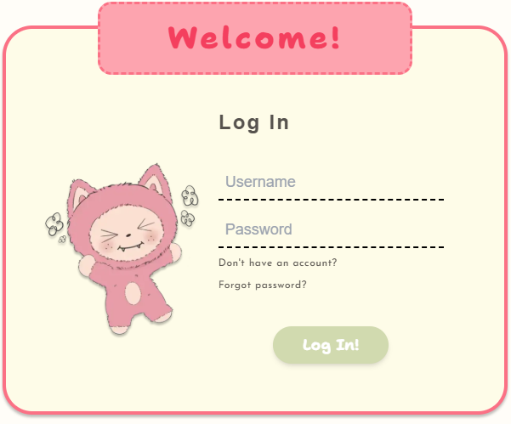
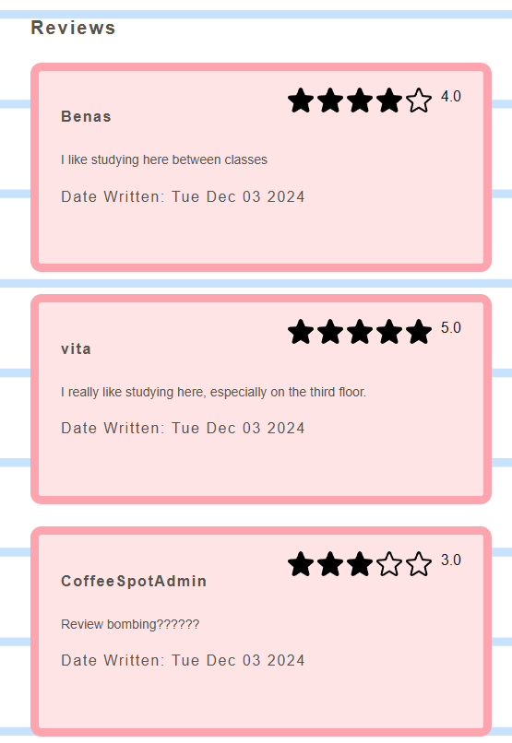
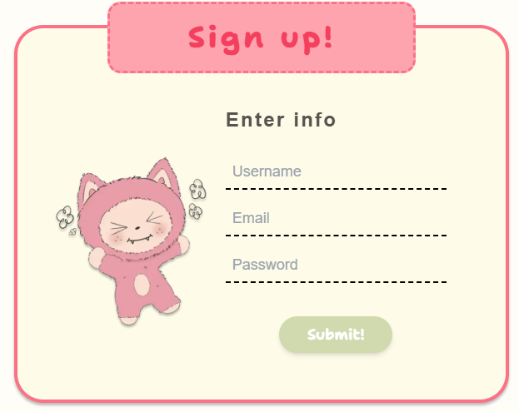
User Functions
User Function Users can Register, Login and Logout, Leave Reviews and Change general information about themselves.
Reviews
Coffee Spot allows users to leave their own reviews and ratings, helping other users find the best coffee shops and providing valuable feedback to coffee shop owners.

Slide 8
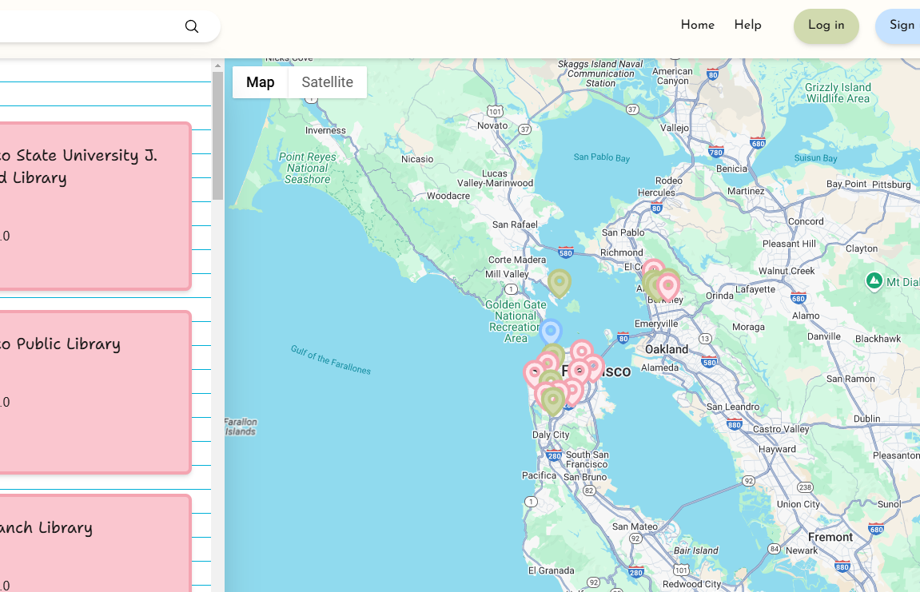
Map Functions
Map Pins
Pins on the map represent the locations their colors change base on the location type and they will display some information about the location Location Filters
Users can customize their search with filters on the left, ensuring they find exactly what they need quickly and easily.

Slide 9
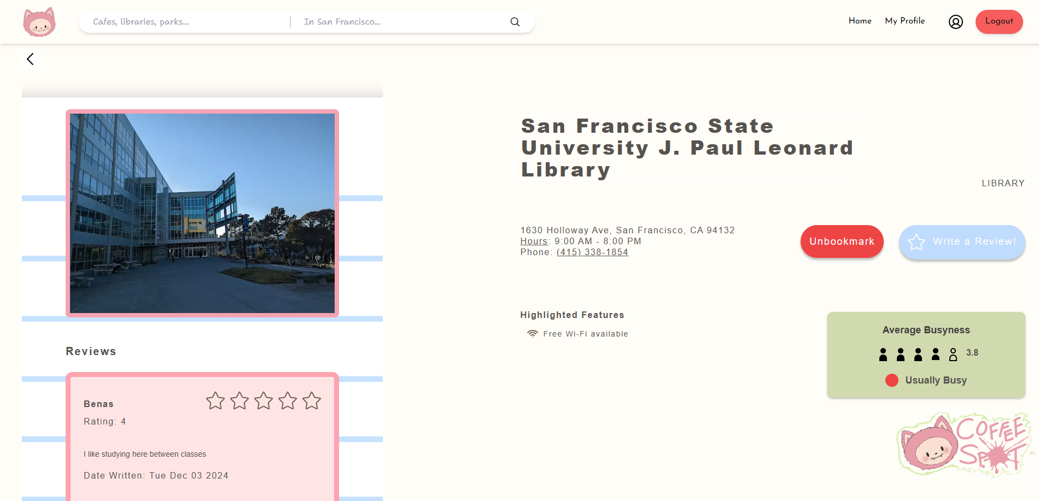
Location Profiles
Detailed Location Profiles
Coffee Spot provides detailed information on each location, including photos, address, opening and closing hours, user reviews, and how busy a place is, making it easy for users to find and choose best spot.

Slide 10
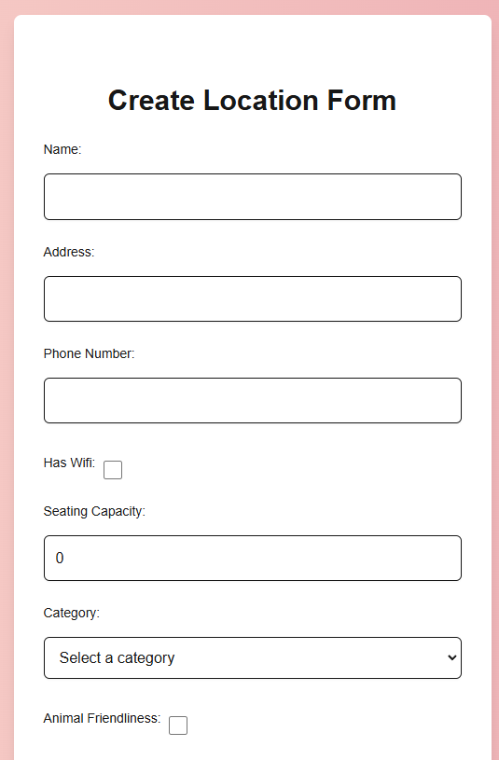
Back End Functions
Vercel Blob
Vercel has a solution to storing files and since we are already on Vercel it made it easier for us to use
Admin Functions
Admins can add, edit and remove locations.

Slide 11

Development – Front End

Slide 12
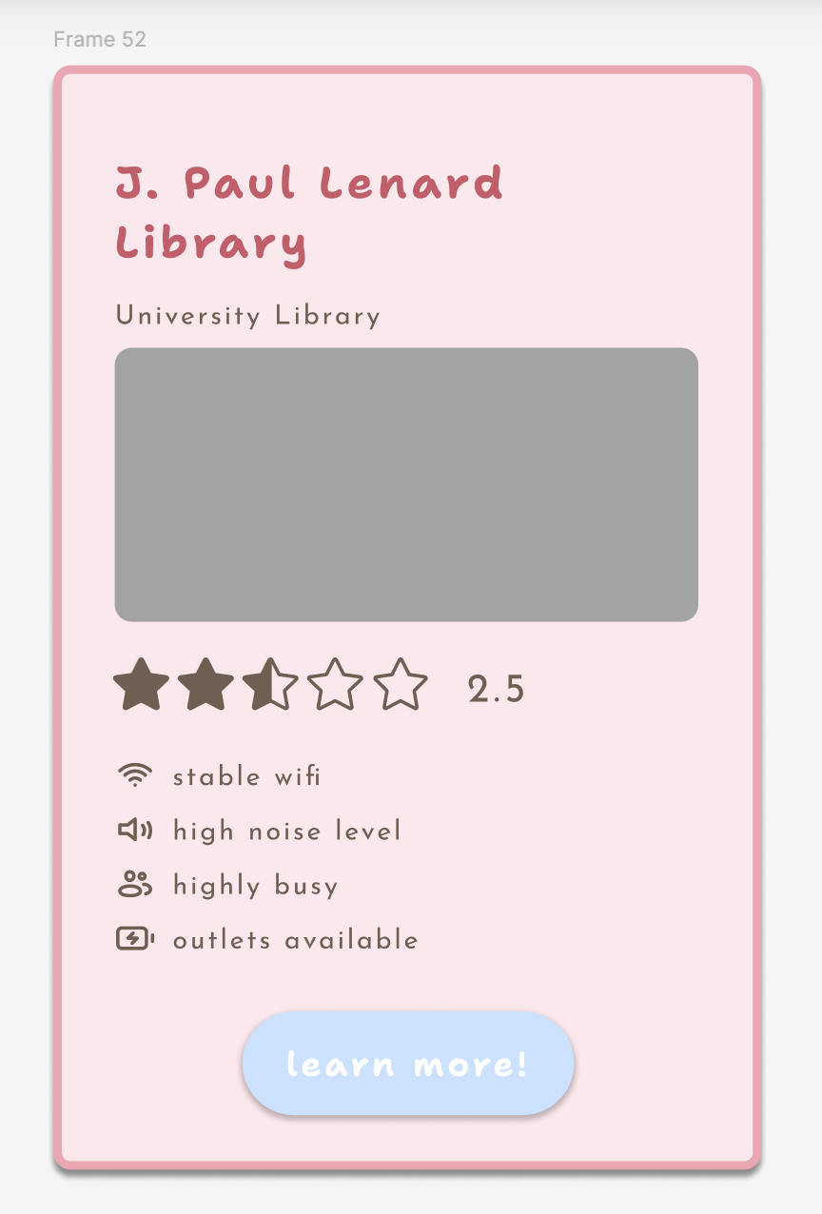
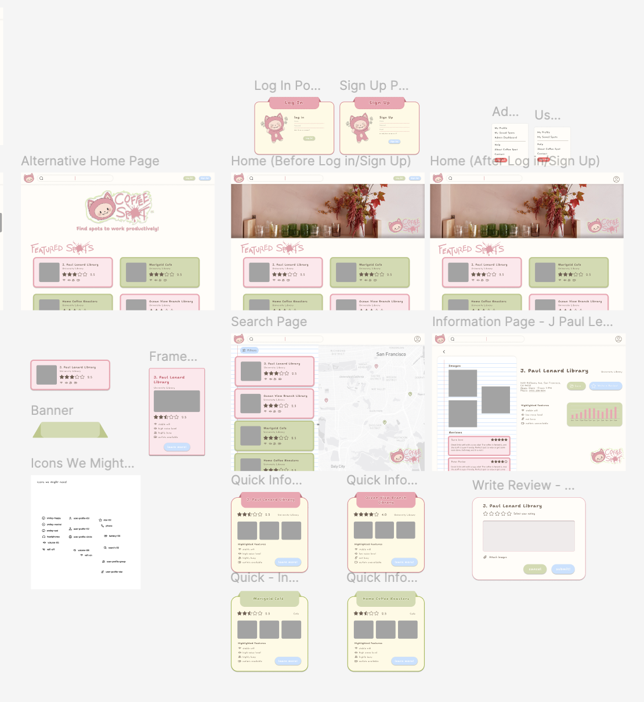
Designing Catffeine and UI Elements
Utilizing Figma
The majority of the UI/UX was created utilizing figma. Figma allowed for our team to explore a mockup of the site minus the functionality which helped to accelerate the development of coding the front end.

Slide 13

Development of the UI/UX
Adjusting the Design
A common issue was having to adjust elements of the original design due to the technical limitations of our project. Therefore, our team continued to use figma throughout the semester as the design kept developing and evolving.
What I would do differently next time
In addition to having to redesign elements, we also had some issues creating consistency throughout the design as different members worked on different components. To avoid this in the future, it would be helpful to create a more extensive design guideline to share with the team

Slide 14

Using Builder.io
Builder.io
One of the tools we used to help bring the front end to life was builder.io. In the beginning we were utilizing the AI to convert pieces of our design into code but we quickly realized the code was not well written therefore we opted to code without the use of AI.
Technology
We built the front end by breaking up everything into components so that other members not on the front end team were able to help contribute pieces to the overall design. It was also the first time working with typescript and tailwind css for many of us.

Slide 15

Development – Back End

Slide 16
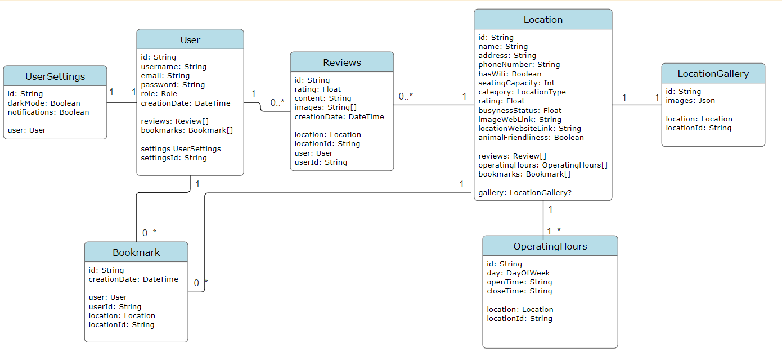
Database
Mongodb Atlas
Used because it was free and requires minimal setup
Prisma ORM
ORMs help abstract away writing queries.
Made sure to have cascading deletes if the one in one to many gets deleted.

Slide 17
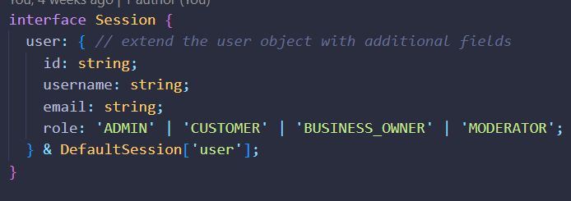
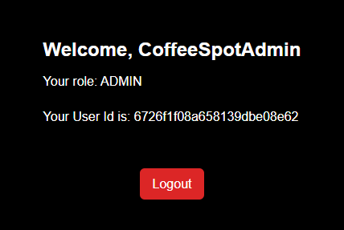
Authentication & Authorization & Security
NextAuth.js V4 Login using Username and Password
Users cannot access certain pages if:
They are not logged in.
They do not have sufficient role privileges

Slide 18
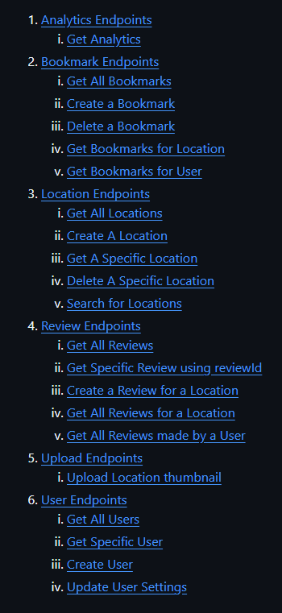
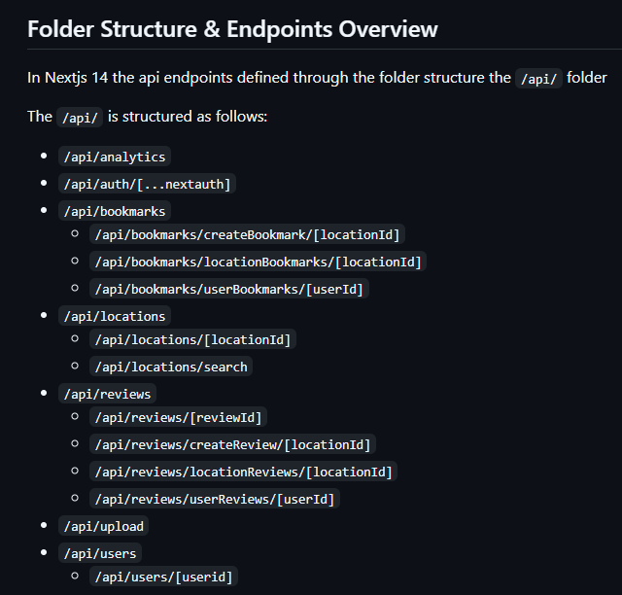
API
21 Endpoints in total for our web app.
Basic Error Handling for all endpoints and logged.
Since we are using Next.js you can choose to design your backend using Server Actions or Route Handler.

Slide 19
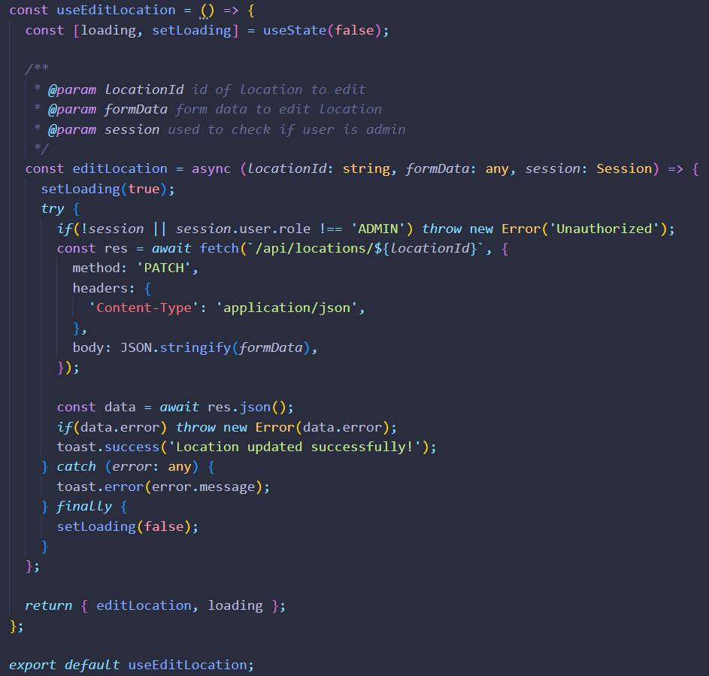
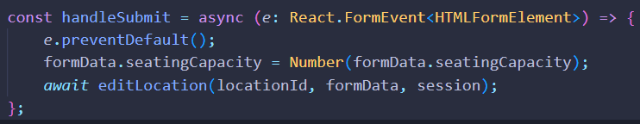
Custom Hooks
Custom Reusable React Hooks were used to encapsulate fetching logic away from the frontend page files.
17 Custom hooks were made by the Backend Team for the Frontend Team

Slide 20

Takeaways

Slide 21
There are a few things we didn’t get to do: Modal Components for the Log in
Recommendation Algorithm
Reservation Functions More Team Building Events
(We went for sushi once and had coffee together. We plan on hotpot at some point)

Slide 22
Up Next: Demo

